Slide 1
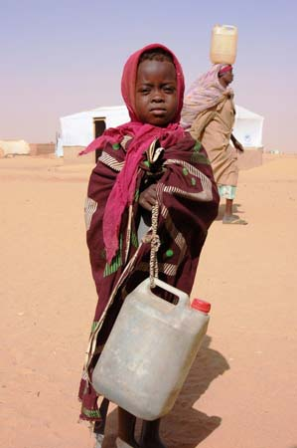
Refugee Migrants
Learning Objective: Explain what a refugee is and explain some of the difficulties they may face
Starter:
1. Give one negative impact of migration on a receiving country.
2. Give one positive impact of migration on a source country.
‘3. Refugees move solely because of PUSH factors’. Suggest what this means.

Slide 2
True or False?
Most asylum seekers come from countries which are at war
Refugees bring crime to this country
Refugees get big state hand-outs
Britain’s population is growing because of refugees
Everyone in the world has the right to claim asylum
Refugees are mostly skilled and well qualified
Britain takes more refugees than any other country
Britain’s population is growing because of refugees
Most refugees want to go home
Answers at the end of the lesson!

Slide 3
Define the following…
Asylum Seeker
              Refugee
What is the difference between an asylum seeker and refugee?

Slide 4
Definitions
Asylum Seeker- Someone claiming safety in another country
Refugee- people who have fled from their homes in one country, usually against their will, to seek a more secure life elsewhere

Slide 5
http://www.redcross.org.uk/What-we-do/Refugee-services/Refugees-true-stories/Video-diaries
http://www.bbc.co.uk/news/world-africa-14017637
http://www.bbc.co.uk/news/world-africa-14033767

Slide 6
Look at the headline you have been given.
What message does your headline send to its readers?
Do you think it is a fair representation of teenagers today?
http://www.mercycorps.org.uk/files/file1185791109.pdf

Slide 7
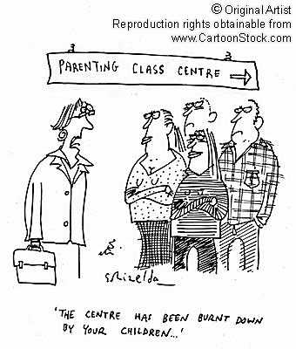
'Hoodies' menacing London
Teens' destructive stunts becoming more violent
Sunday, June 19, 2005
What message does this send out to the public?
Is this a fair representation?

Slide 8
Headline about Asylum seekers and Refugees
Asylum Seekers raising HIV Risk
Daily Mail, 2006
Struggling Schools Swamped with asylum seekers.
Daily Mail, 2006
Scottish Terror Suspects Were Refugees
Scotsman, Jan 2003
THE ILLEGAL IMMIGRANT WHO RAPED A GIRL OF 12
The Mirror, June 2006

Slide 9
1. Describe your source
5. To what extent do you think these people would be welcomed in the UK?
2. Explain what it shows
Thinking Star
4.Imagine you were in the image. How would you feel?
3. If you had to use ONE word to sum up the photo what would it be?

Slide 10
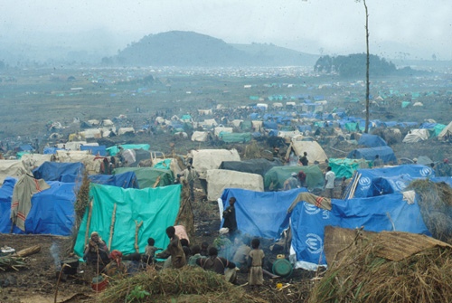
Source 1

Slide 11
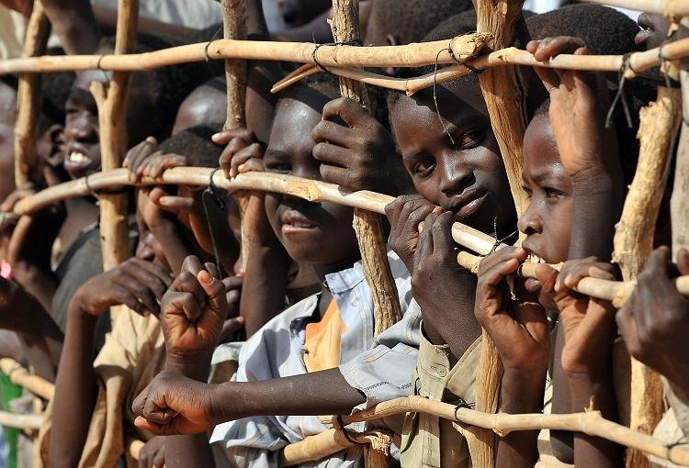
Source 2

Slide 12
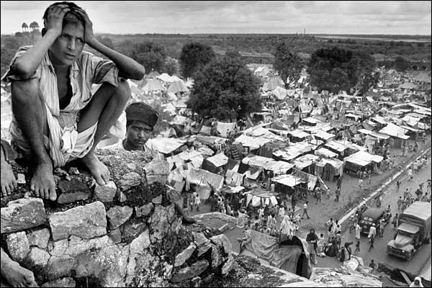
Source 3

Slide 13
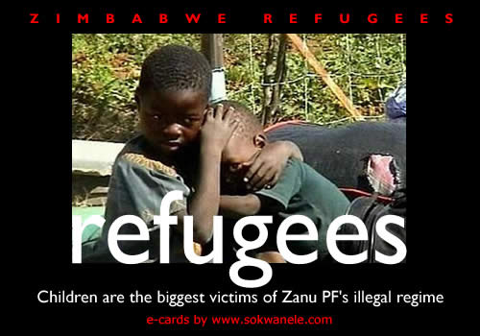
Source 4

Slide 14
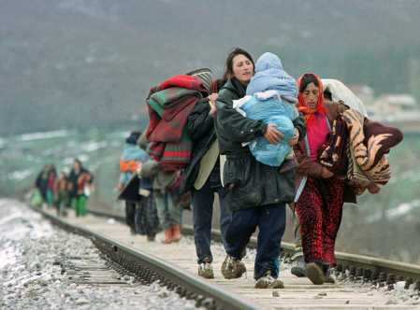
Source 5

Slide 15
As far as some people are concerned, asylum seekers can’t ever get it right. If they work, they are stealing our jobs, if they don’t work they are draining our economy. Neither of these are true – furthermore, asylum seekers are not allowed to work. Refugees come here because they are in danger in their own country. When they get here, they are treated like criminals all over again. If the media were to be more balanced and factually correct and if politicians tried to challenge these misconceptions instead of pandering to them, it would be much more helpful to the world in general.

Slide 16
True or False?
Most asylum seekers come from countries which are at war
Refugees bring crime to this country
Refugees get big state hand-outs
Britain’s population is growing because of refugees
Everyone in the world has the right to claim asylum
Refugees are mostly skilled and well qualified
Britain takes more refugees than any other country
Britain’s population is growing because of refugees
Most refugees want to go home

Slide 17
Plenary
My misconception about refugees was…. It has been challenged by….

Slide 18

What two things have you done to work towards your target?

Slide 19
