Slide 1
3. Management issues and strategies
Sub-topic | Development | Teaching hours | Reflection/Notes
Dams and reservoirs | Examine the hydrological changes resulting from the construction of dams and reservoirs. Examine the costs and benefits of dams and reservoirs as part of multi-purpose schemes. | 2 hours
Floodplain management | Explain the stream channel processes (erosion, transport, deposition) and explain the resultant landforms found on floodplains. Examine the human modifications of a floodplain and their effect on the size and probability of floods. Evaluate the costs and benefits of alternative stream management strategies. | 3 hours
Ground water management | Explain the functioning and management of artesian basins and aquifers, distinguishing between natural and artificial recharge. Examine the environmental impacts of groundwater abstraction. | 2 hours
Freshwater wetland management | Describe the role of wetlands as a water resource. Evaluate the effectiveness of the management strategies that have been adopted in a major wetland. | 2 hours
Irrigation and agriculture | Examine the environmental impact of agriculture and irrigation on water quality: salinization, agro-chemical runoff, the pollution of groundwater and the eutrophication of lakes, rivers and wetlands. | 3 hours

Slide 2

Starter Activity: The Great Artesian Basin
Artesian- relating to or denoting a well bored perpendicularly into water-bearing strata lying at an angle, so that natural pressure produces a constant supply of water with little or no pumping.
Starter: Complete the questions and statements below.
The Importance of groundwater in central Australia is………….
__________________________________________________________
The water is how old? …… _______________________________________________________
The Artesian Basin is located ……………..
__________________________________________________________
What is the Geology of the region? –__________________________________________________________
What is the meaning of Permeable and Impermeable?
__________________________________________________________
Total area of the basin & recharge
__________________________________________________________
Total amount of water in the basin
__________________________________________________________
2 million
North East Australia
Clay and silt and Sandstone
22% of Australia
65000 million mega liter’s

Slide 3
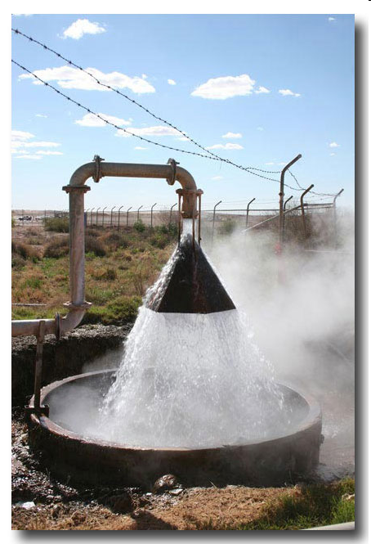
Management of artesian basins and aquifers
Learning Objective: To be able to explain the functioning and management of artesian basins and aquifers.
Demo: How is water extracted from the artesian basins and aquifers?
Manmade
Natural
Challenge: Can these be categorised?

Slide 4
Management of artesian basins and aquifers
Demo:
1a.What are the causes of Groundwater usage?
1b. What reasons might there be for groundwater to be recharged?
Causes of Groundwater Usage
Causes or Groundwater Recharge
Evapotranspiration from shallow stores, capillary action will draw moisture up to near the surface Natural discharge by springs and into lakes, rivers and oceans Artificial abstraction (removal) for domestic, industrial and agricultural use Leakage into nearby aquifers Interbasin transfers | Artificial recharge. Either leakage from irrigation channels and reservoirs or the pumping of water into aquifers. Infiltration and percolation after precipitation or snow melt Seepage from river channels, lakes and oceans Leakage from nearby aquifers Interbasin transfers

Slide 5
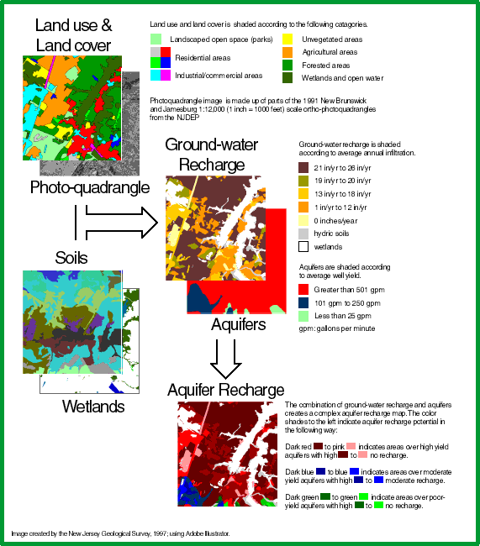
How do we map aquifer recharge areas?
The method uses rainfall data from climate-monitoring stations, maps showing how the land surface is currently used (residential, agricultural, commercial, wooded, pavement, etc.), what kind of soils occur at the earth's surface, and the extent of wetlands (streams, rivers, lakes, marshes, and bogs). These data are combined using scientific methods to determine how much ground water is available in any particular area for recharge to the local aquifer.

Slide 6

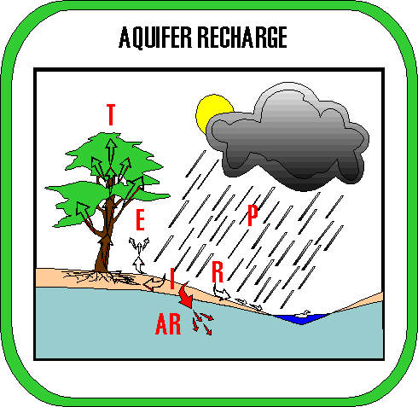
Recharge Rates
Demo: Look at the animation below and create a key for the letters provided.
Precipitation,
Runoff,
Infiltration,
Evaporation, Transpiration,
Aquifer Recharge
What is aquifer recharge?
Aquifer recharge is the process by which rainwater seeps down through the soil into an underlying aquifer. There are many natural processes that determine how much rainwater actually reaches and replenishes an aquifer instead of being evaporated, consumed by plants and animals, or simply running off the ground surface into streams, rivers, lakes, and oceans.

Slide 7
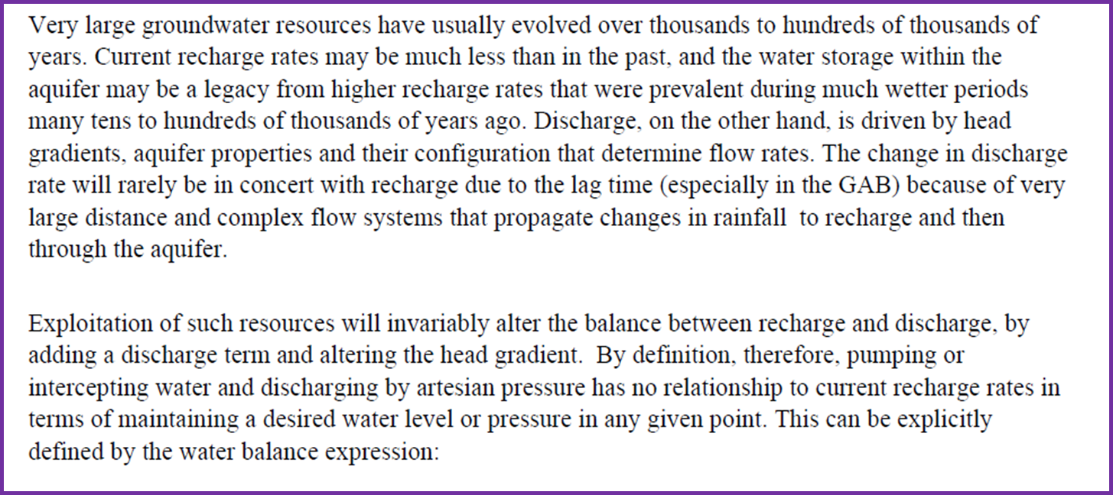
Recharge Rates (Short Reading)
Demo: Read through the text below.
Key Terms:
Head Gradient -H is a measure of the mechanical energy that causes groundwater to flow.
Lag time – period of time between the peak rainfall and peak recharge.
Key fact:
Total recharge area of the basin is estimated to be about 10% of the total area with an annual recharge volume of 1000 GL/year.

Slide 8
Processes of the GAB - AUS
Demo: Look at the spider diagram below. What links can be made to and added to the diagram. This can be factual information,geographical concepts and ideas, geographical language.
Extraction
Management
Impacts
Social
Economic
Environmental
Political

