Slide 1
Disparities and Change
Learning Objective: To be able to explain the changes that have occurred in the patterns and trends of regional and global disparities of life expectancy, education and income.
Starter: Make a sketch of Rostow’s model.
The age of high mass consumption
The drive to maturity
W.W.Rostow (Modernisation Theory)
Take-off
A rise in the rate of productive investment to over 10% of national income
The development of one or more substantial manufacturing sectors with a high rate of growth
The emergence of administrative systems that encourage development
The preconditions for take off
The traditional Society
Decades

Slide 2
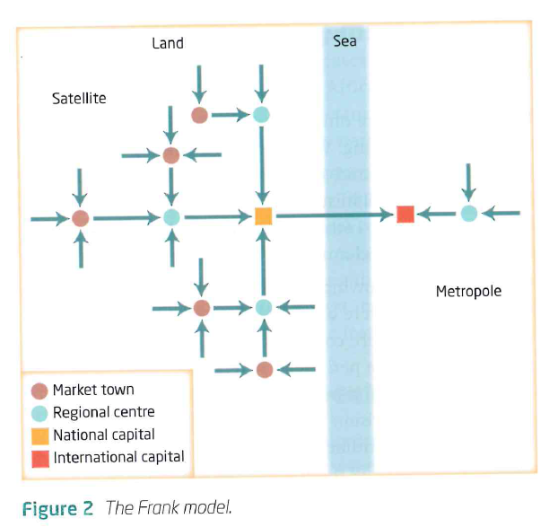
  Dependency Theory
  Demo: Summarise the notes on the right on Gunder Frank’s “dependency theory”.
  Andre Gunder Frank 1966
  Took a historical approach:
  poverty in the developing world arose through the spread of capitalism and that many countries had been prosperous before the arrival of European colonists
  The process of absorption into the capitalist system sowed the seeds of underdevelopment
  The development of the rich world was achieved by exploiting the raw materials of the developing world
  Developing countries became even more dependent on the rich countries by farming export crops where once local food crops prevailed
  The stronger the links to the developed world the worse the level of development
  Challenge: Describe Frank’s simple model?

Slide 3
  Dependency Theory
  Challenge: Describe Frank’s simple model?
  Frank used a simple model to explain how the “metropolis” (the developed world”) exploited the “periphery”(the developing world). The model shows a chain of exploitation which begins with small towns in the periphery expropriating surplus from the surrounding rural areas. This process of exploitation works its way up the urban hierarchy in the periphery until, finally, the largest settlements are exploited by cities in the metropolis. The intensity of poverty increases with the number of stages down the chain of exploitation.
  Frank and others saw socialist systems of government as providing a better basis than capitalism for fairer society, both between countries and within countries.

Slide 4
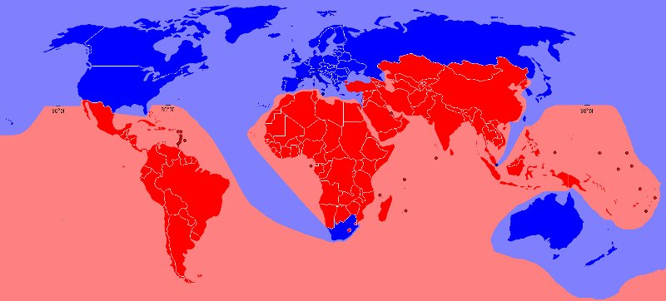
Cores (network hubs/nodes), peripheries and those areas in-between!
Demo: What is being represented on the map?
In the ‘global south’ living conditions are low due to low amounts of wealth
In the ‘global north’ living conditions are high due to high wealth

Slide 5
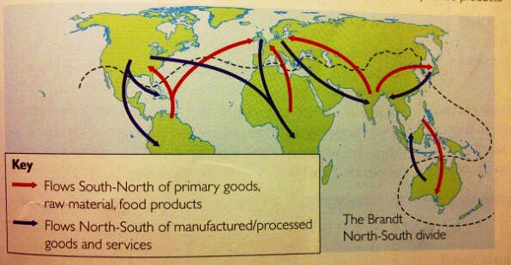
Brandt-Line

Slide 6
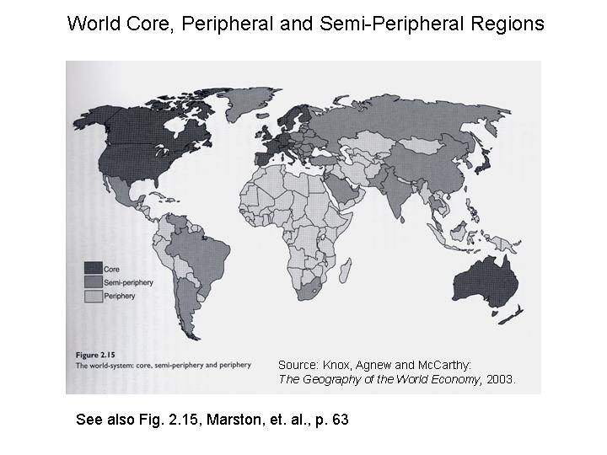

Slide 7
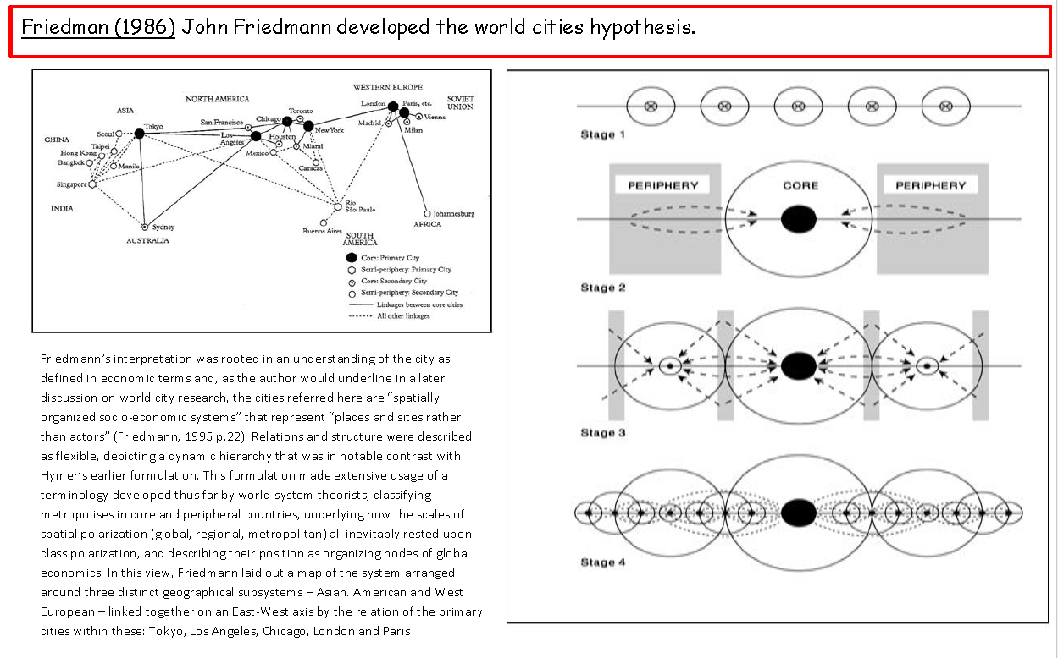
Cores (network hubs/nodes), peripheries and those areas in-between!
Friedman (1966)

Slide 8
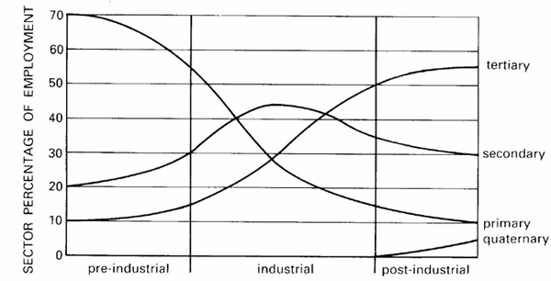
Clark-Fisher model

Slide 9
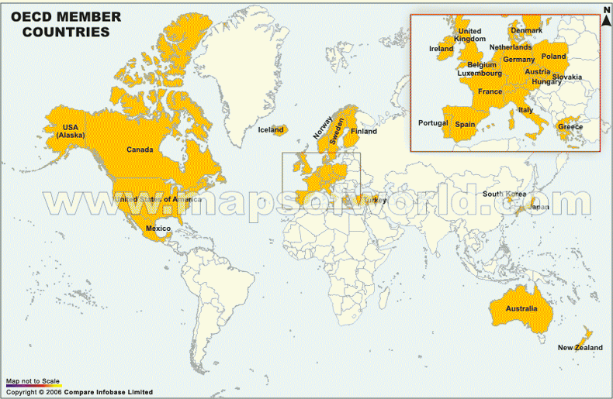
Organisation for Economic Co-operation and Development
The Organisation for Economic Cooperation and Development (OECD) is a group of 34 of the richest and most powerful countries.
The top eight are called the G8 – one of the world’s most powerful and wealthy groups – it’s made up of Canada, France, Germany, Italy, Japan, Russia, USA and the UK
They meet to discuss and provide possible solutions to economic, environmental and social issues
Members of the OECD are always changing too, e.g. Potential new members include Brazil, China, India and more recently South Africa (BRICS)

Slide 10
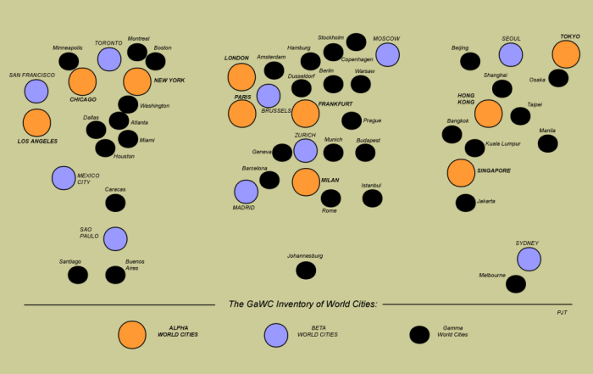
Cores (network hubs/nodes), peripheries and those areas in-between!

Slide 11
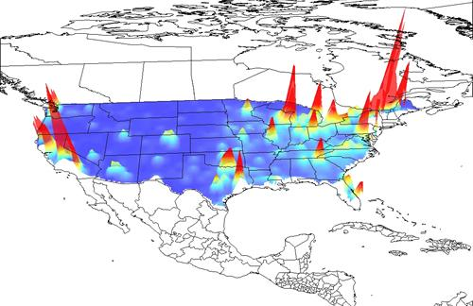
Gecon globe

Slide 12
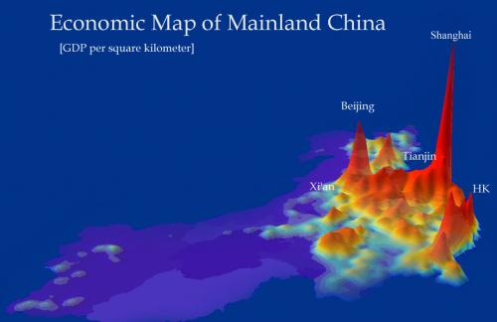
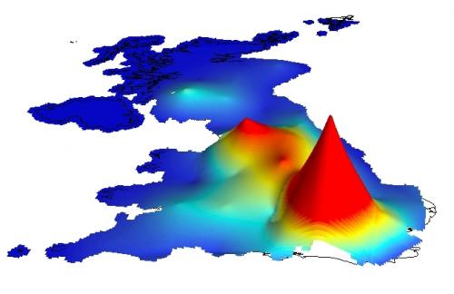

Slide 13
Disparities and Change
Learning Objective: To be able to explain the changes that have occurred in the patterns and trends of regional and global disparities of life expectancy, education and income.
Demo: Look at your map/table or graph. What can you infer from this source? Justify your reason
Life expectancy
Education
Income
Tip: What has happened to global convergence?
What influences might there have been on life expectancy?
Tip: What is the trend showing?
What changes might have helped this change in trend occur?
Tip: What is the trend showing?
What changes might have helped this change in trend occur?

Slide 14

Assessment for learning
Learning Objective: To be able to explain the changes that have occurred in the patterns and trends of regional and global disparities of life expectancy, education and income.
Please complete the activity below reflecting on your learning so far in today’s lesson:
So far in this lesson, I have learnt:

Slide 15
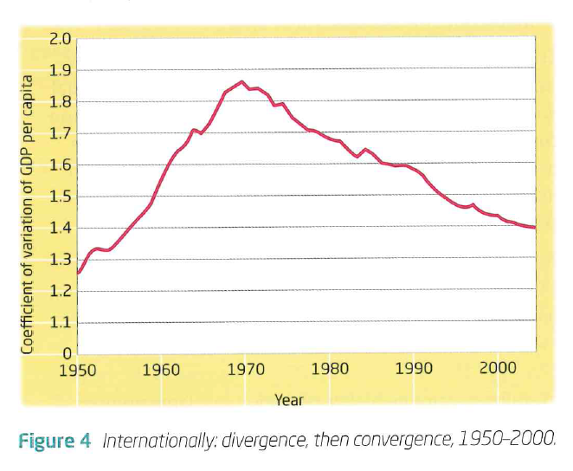
Income

Slide 16
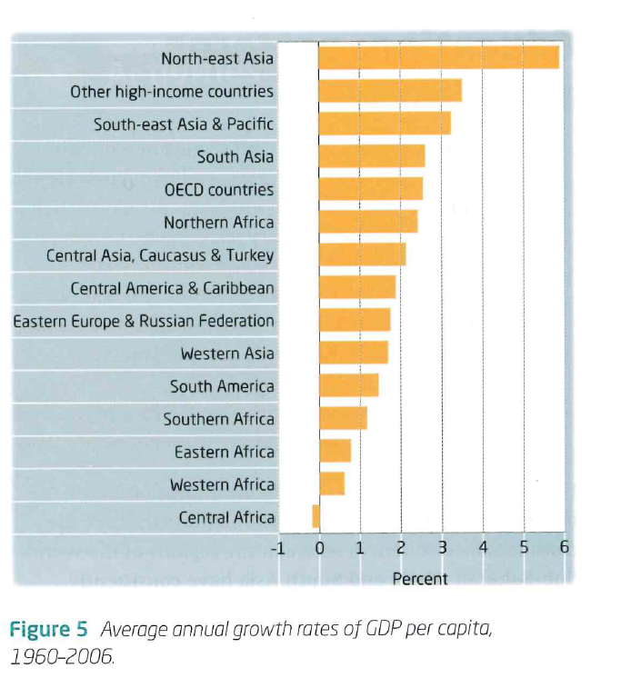
Life expectancy

Slide 17
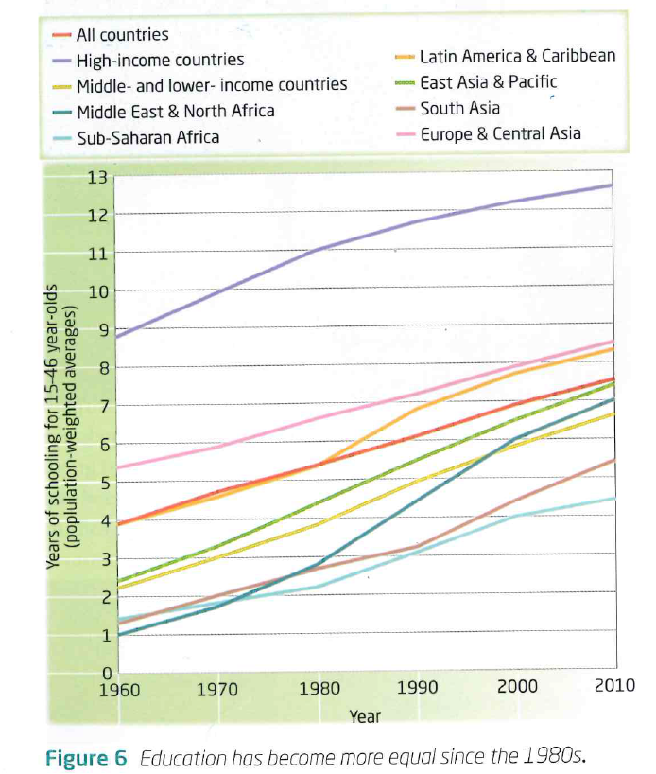
Education

Slide 18
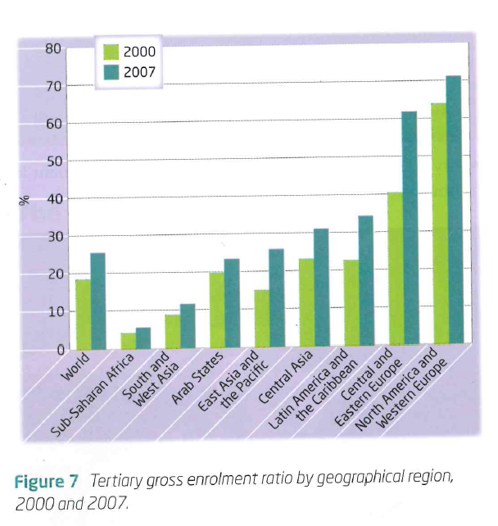
Education

Slide 19
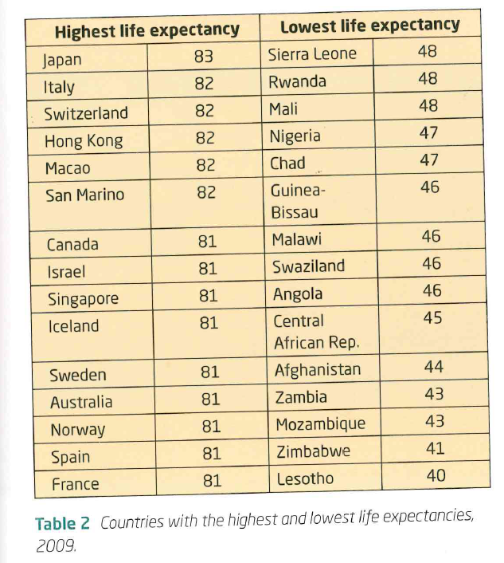
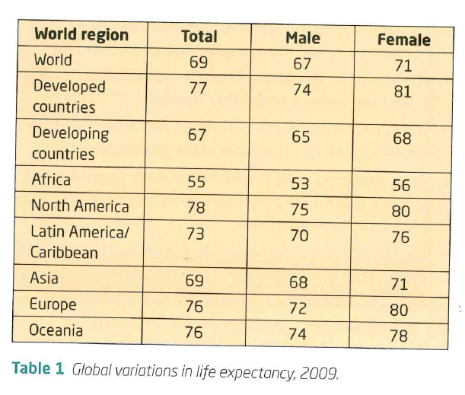
Life expectancy

